Slide 1
ECLAT Algorithm
Saaki V. & Brett T.

Slide 2
Eclat algorithm was introduced to deal with the weakness of the Apriori algorithm. Between these two algorithms, we have significant differences:
Eclat algorithm is applicable only with a dataset in vertical dataset format.
Associative Rule Mining
In the Eclat algorithm, only the support and confidence is counted as confidence. As in the case of Apriori, it is not computed. Here, the Support is nothing but the number of times an item is in a database.
Eclat scans over the database once, it is much faster than the Apriori algorithm.
On the contrary, Apriori is better for larger datasets, whereas Eclat is better for smaller ones
Mostly used for recommendation systems
Can be used as insights for grocery stores to know where to put items that are frequently bought together

Slide 3
Issues
We originally had a dataset that was too big
Caused the model to run for over an hour
Another cause for why the model took a long time to run is due to the minimum support (correlation)

Slide 4
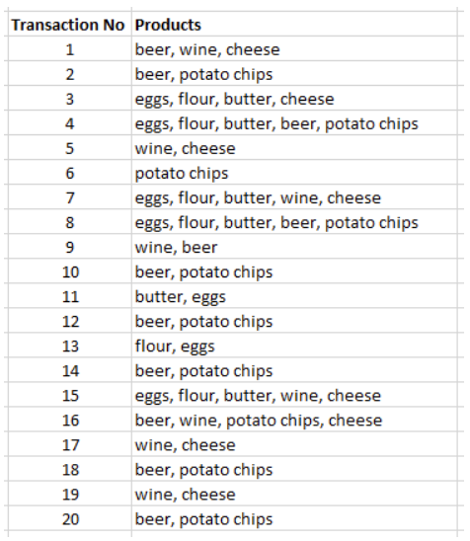
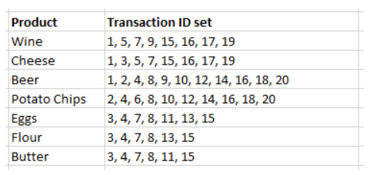
Step 1: List the Transaction ID set of each product

Slide 5
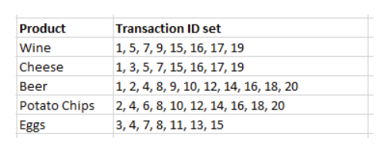
Step 2: Filter with Minimum Support
Minimum Support value of 7. Removed Flour and Butter because they had a TID set of less than 7 transactions

Slide 6

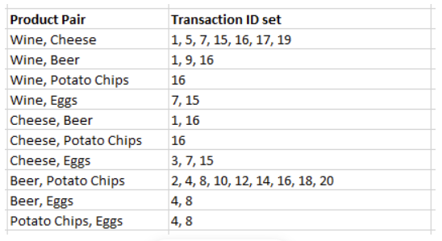
Step 3: Compute TID set of each product pair
The ECLAT algorithm is faster because it is much simpler to identify the intersection of the set of transactions IDs than to scan each individual transaction for the presence of pairs of products

Slide 7
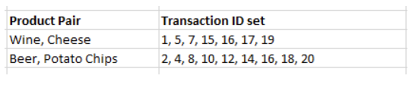
Step 4: Filter out pairs that do not reach minimum support
Filter out results that do not reach the minimum support of 7
Step 5: Repeat as long as you can make new pairs above support

Slide 8
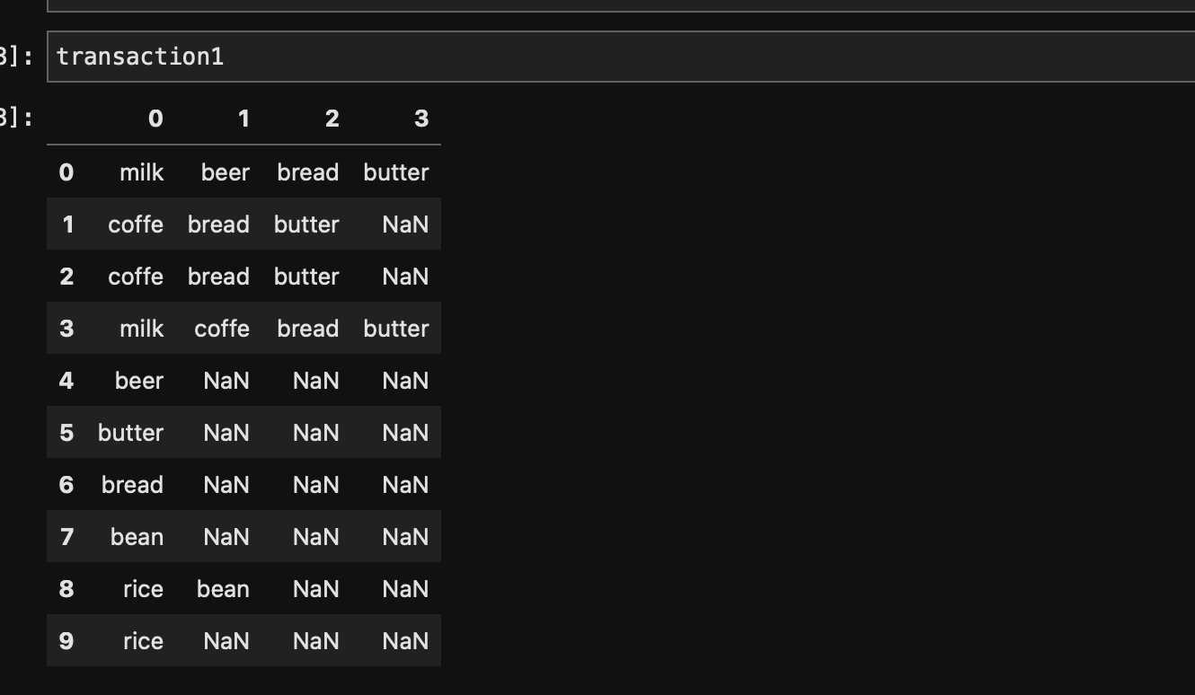
Implementation

Slide 9
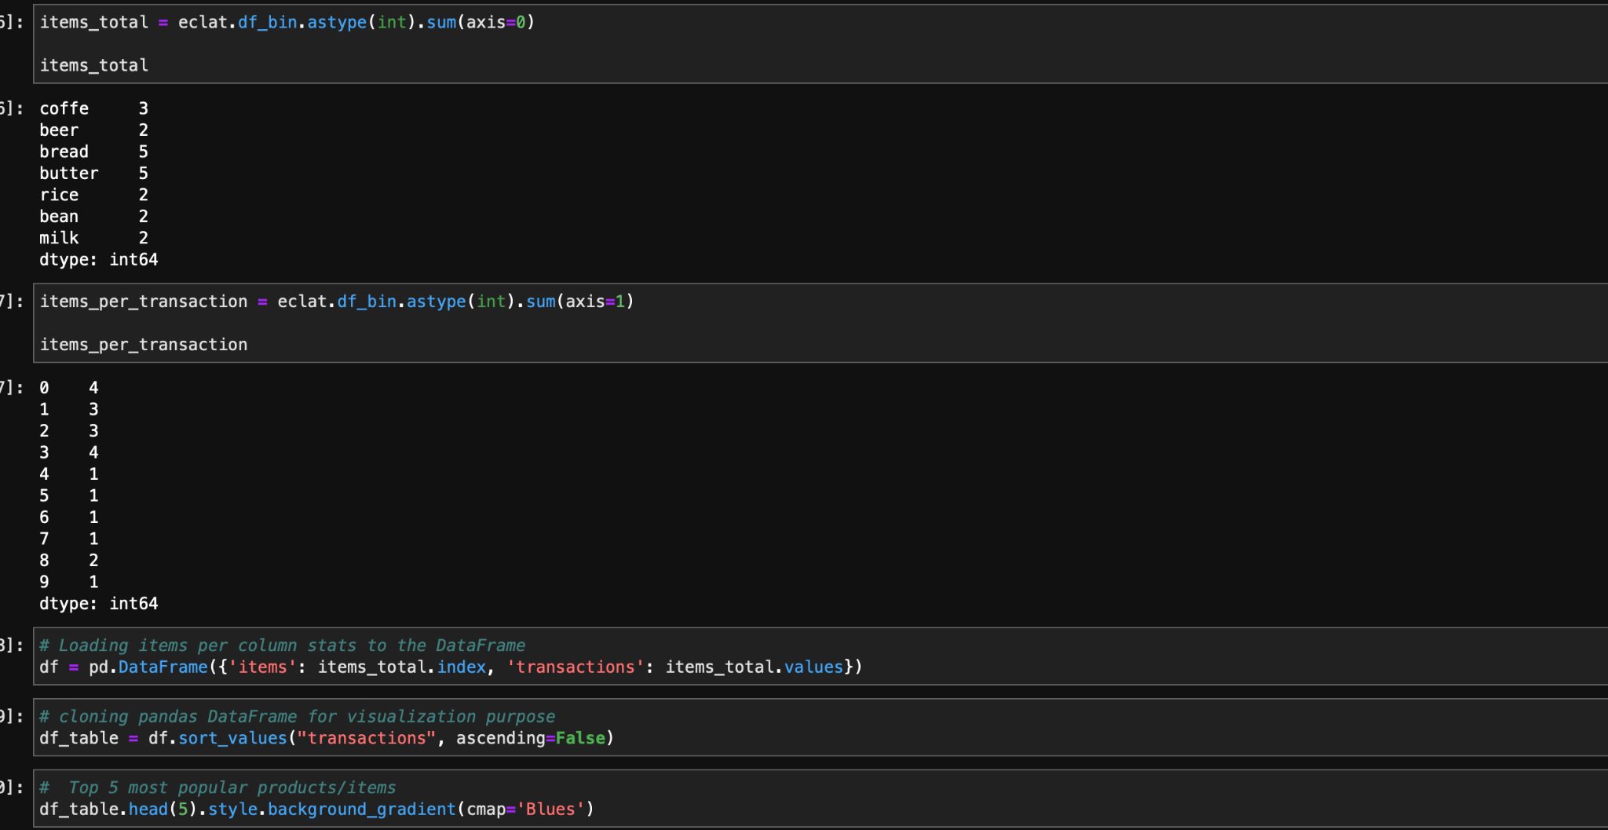

Slide 10
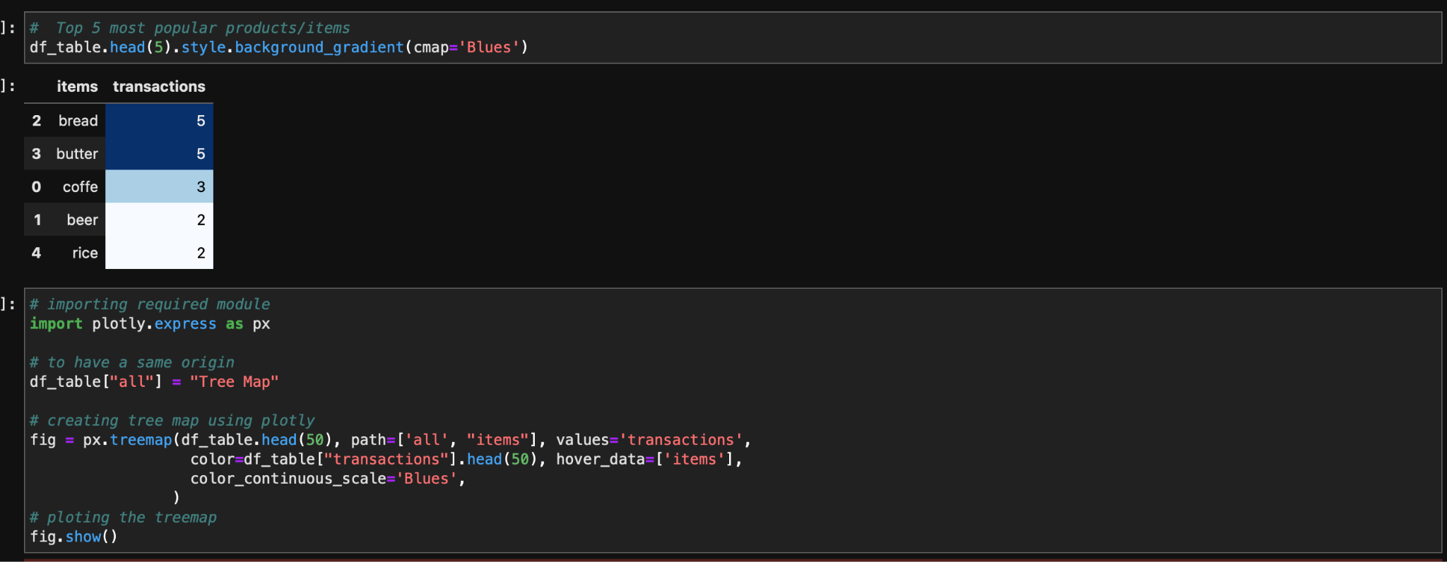

Slide 11
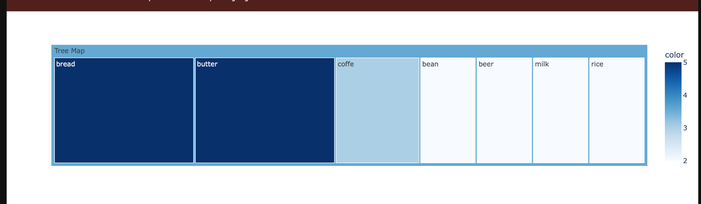

Slide 12
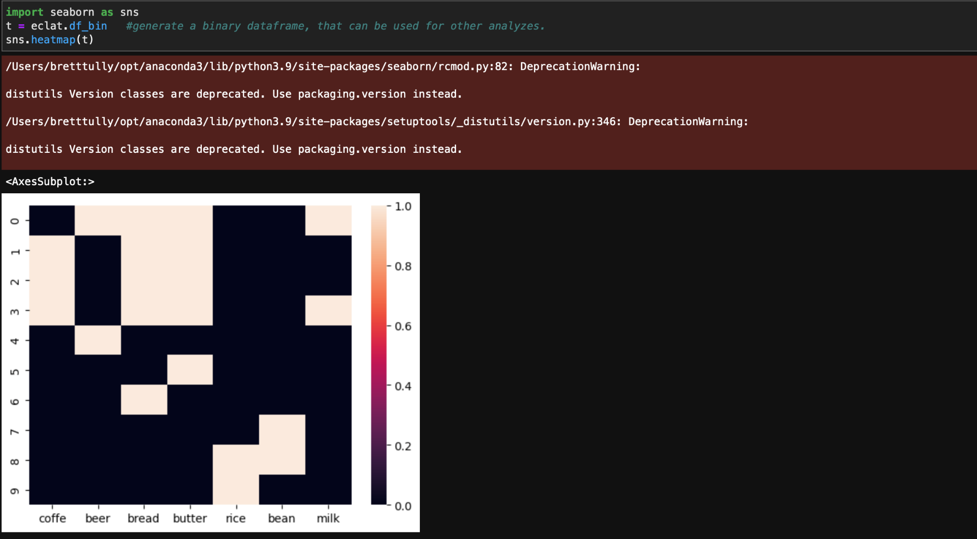

Slide 13
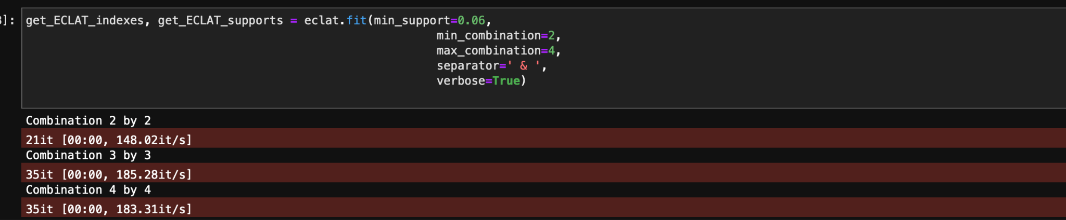

Slide 14
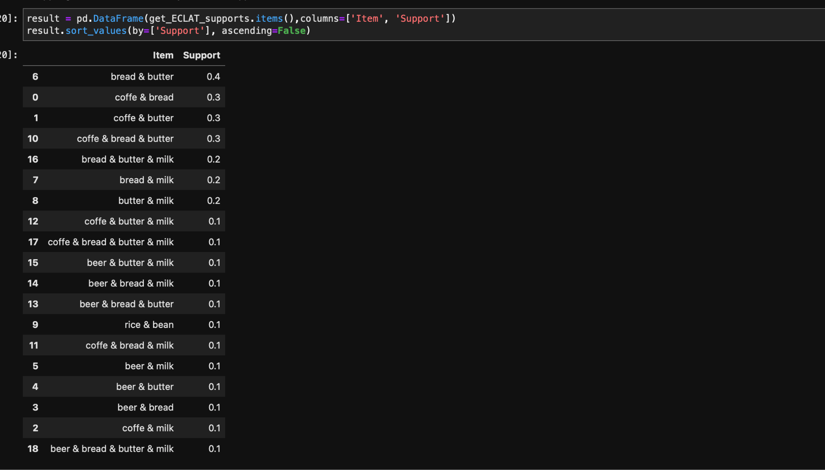

Slide 15
Results
Our results show a somewhat high correlation between bread and butter being bought together at 0.4
Coffee and bread come in 2nd with a correlation of 0.3

